Slide 1
AXA Driver Insurance Telematics Case Study
Presented by: Anil Sener
Date: 14/4/2016

Slide 2
Background info
AXA has provided a dataset of over 50,000 anonymized driver trips from 4,000 Drivers. The intent of this competition is to develop an algorithmic signature of driving type.
Does a driver drive long trips? Short trips? Highway trips? Back roads? Do they accelerate hard from stops? Do they take turns at high speed?
In our case we have 20,000 trips from 100 Drivers. Trips are randomly rotated and standardized by 0,0 starting point.
Trips are presented in 200 CSVs per driver, each csv in x,y coordinates in meters received every second. Total data set size is ~170 MBs

Slide 3






Solution Technical Architecture
DATABRICKS
NOTEBOOK
APACHE SPARK 1.6.1
HADOOP 2-YARN
CSV Files
HIVE
AVRO
FILES
Amazon Web Services EC2 & S3 5 X Large Instances

Slide 4
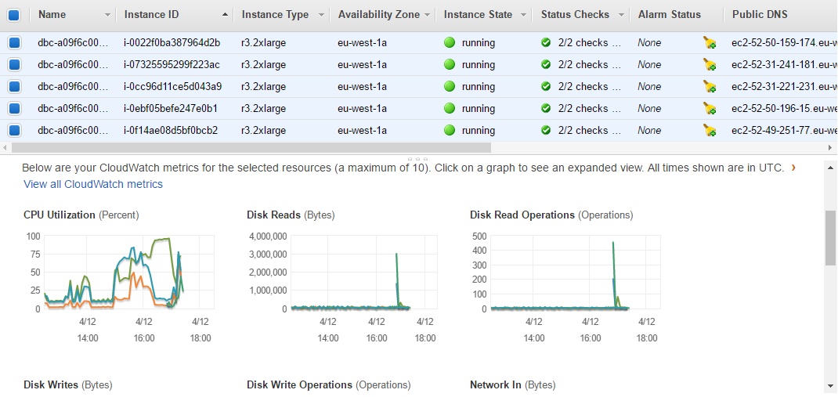
EC2 Servers from Amazon Web Services

Slide 5
Methodology
Data Preparation
Data Understanding
Feature Engineering
Feature Selection
Prediction
Evaluation
Modelling
* All these steps are executed in TEST and PRODUCTION approach

Slide 6
Data Preparation
Aggregating 170 MBs of data, transforming & its storage was a challenge
Luckily Spark in-memory transformations helped to breach these problems without additional burden of Disk I/O
Each Trip coordinate combination was grouped & stored by trip thanks to Spark transformations and AVRO

Slide 7
Data Understanding & Feature Engineering
It is crucial to define the methodology to define a driver telematics fingerprint, answering the questions in the challenge.
This phase was in parallel with Feature Engineering
Thanks to Databricks notebook, it was possible to conduct EDA over this dataset in limited time schedule

Slide 8
Driver Telematic Fingerprint Hints
Do they drive long trips?
Do they accelerate and turn at high speed?
How frequently do they turn? Head Changes?
Do they accelerate hard from stops?
When they are actively driving?
Do they use Backroads, Highways, Repeated Trips?

Slide 9
Do they drive long trips?

Slide 10
Feature Engineering: Trip Distance (m) & Duration

Slide 11
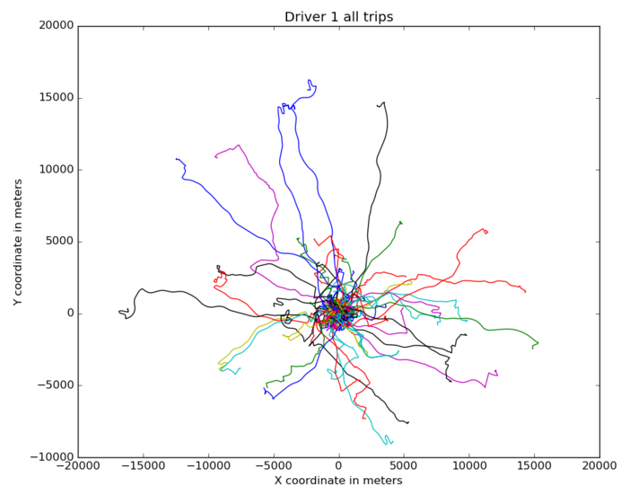
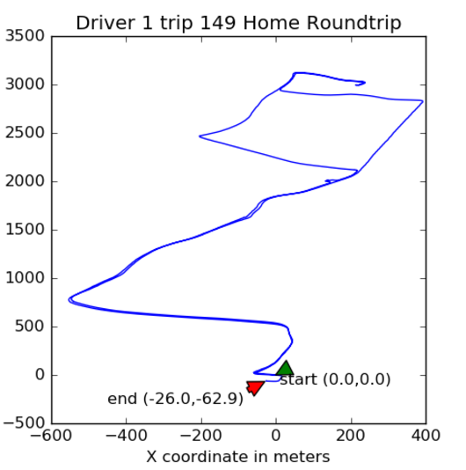
Feature: Trip Absolute Distance

Slide 12
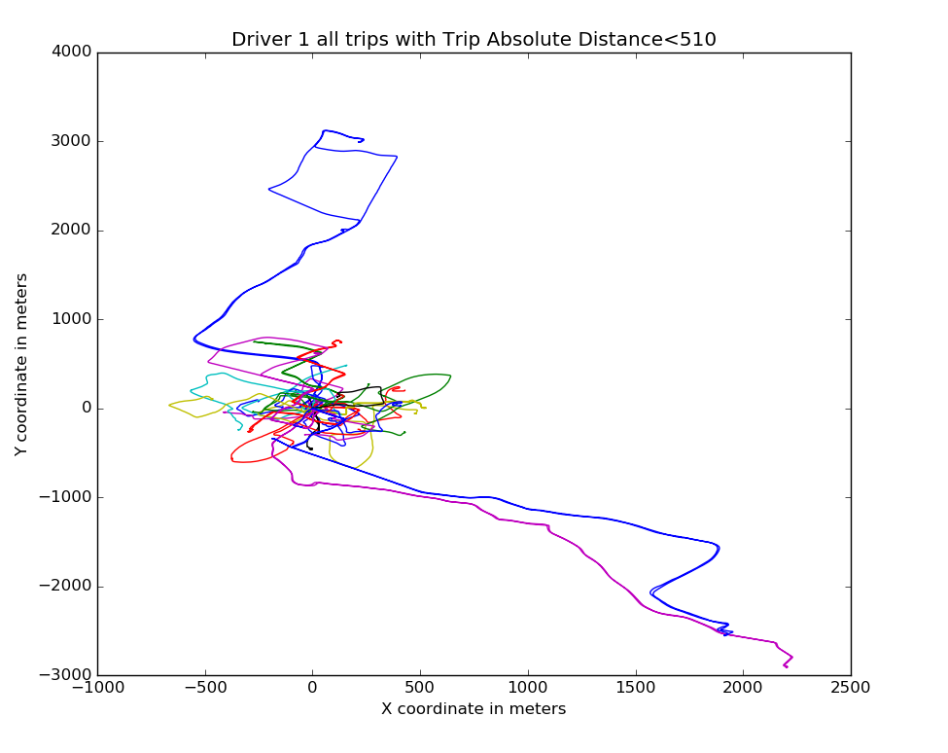
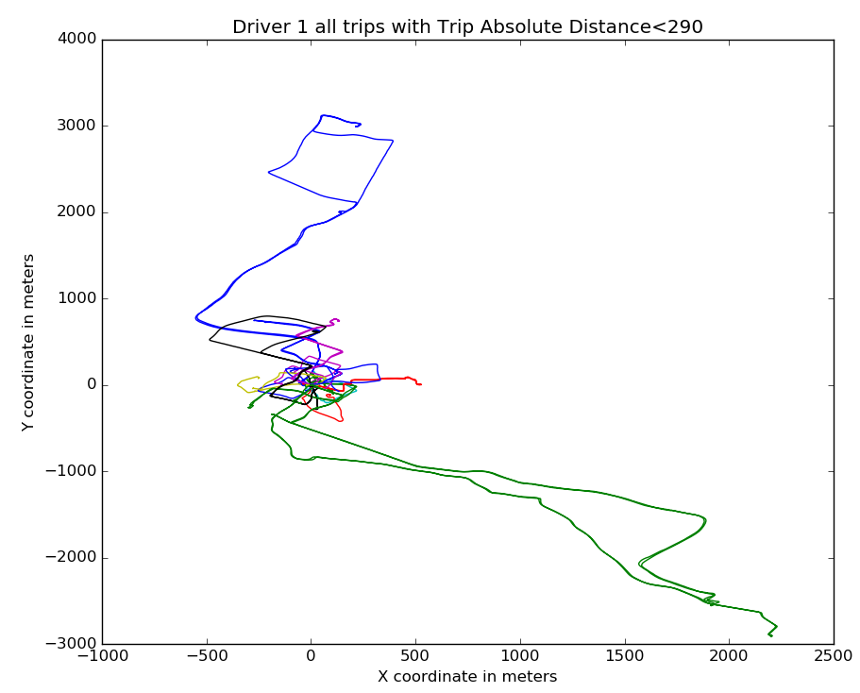
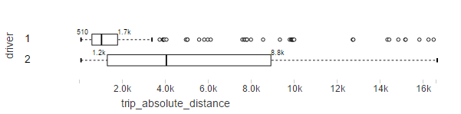
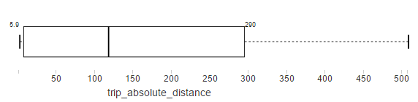
Feature: Trip Absolute Distance

Slide 13
Do they accelerate and turn at high speed?

Slide 14
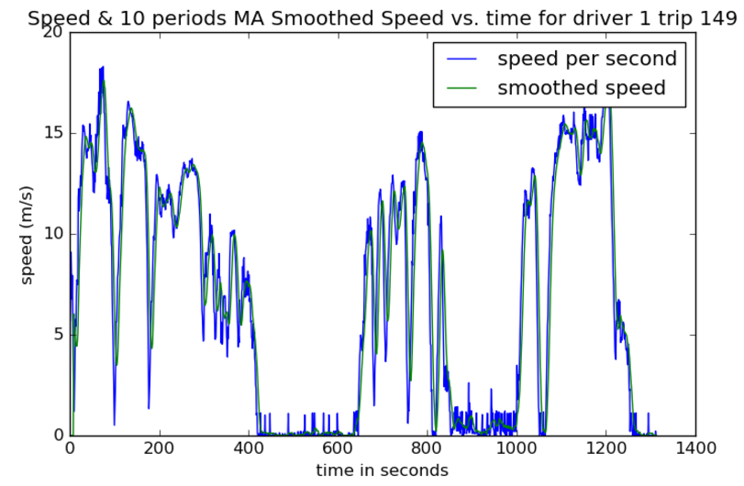
Feature: (Smoothed) Speed Descriptive Stats(m/s)

Slide 15
Feature: Median Acceleration & Breaking

Slide 16
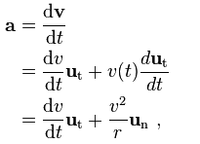
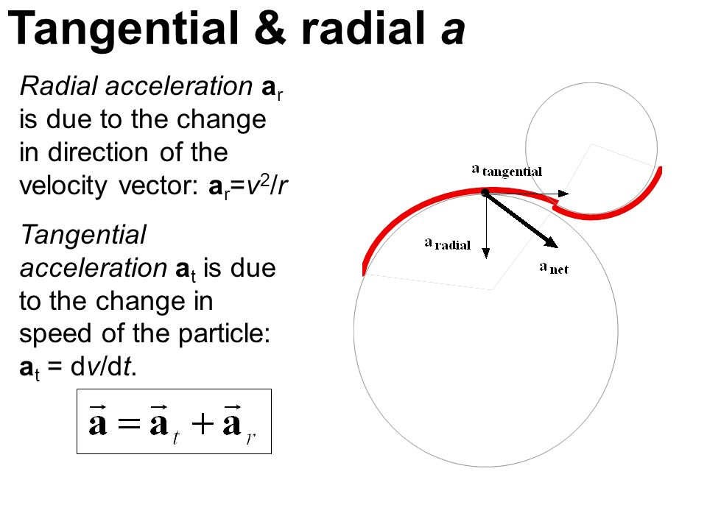
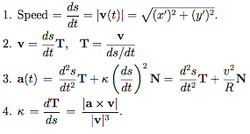
Feature: Circular Acceleration (Desc. Stats) (m/s2)

Slide 17
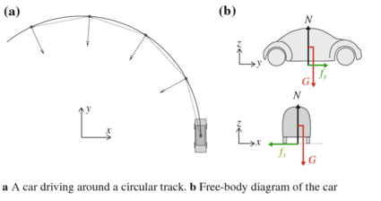
Feature: Circular Acceleration (Desc. Stats) (m/s2)

Slide 18
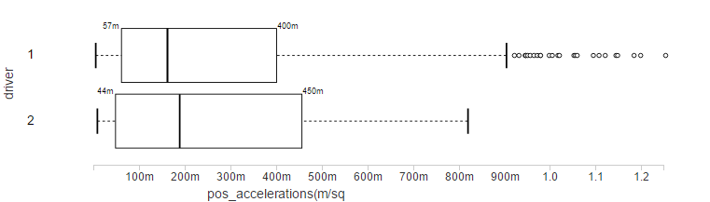
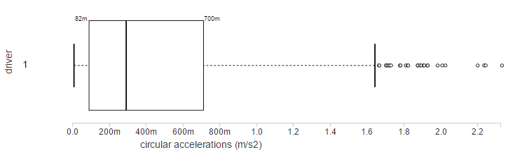
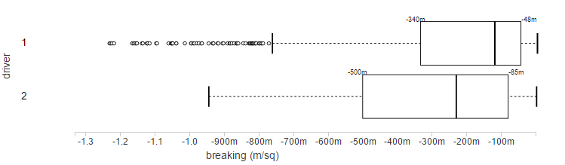
Outliers Identified in Acceleration & Breaking Features

Slide 19
How frequently do they turn? Head Changes?

Slide 20
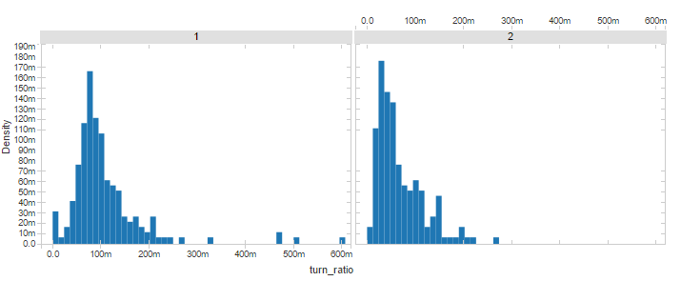
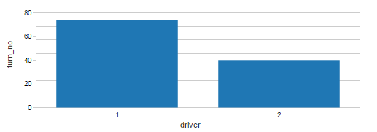
Feature: No of Turns & Ratio of Turns per Trip
Turns are defined based
On angle changes more than 15 degrees in any trip

Slide 21
When they are actively driving?

Slide 22
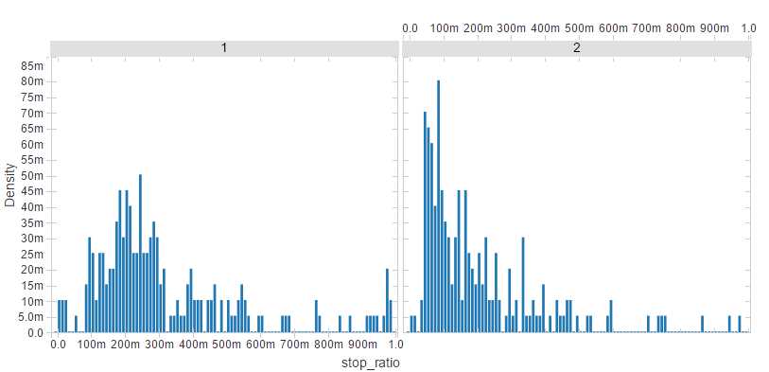
Feature: Stop/Duration Ratio

Slide 23
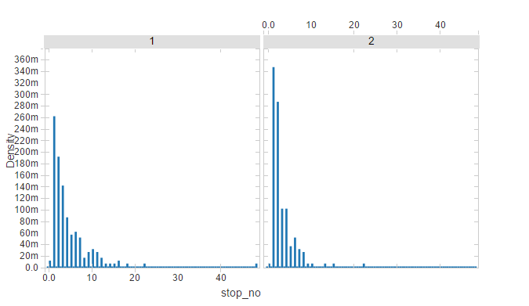
Feature: No of Stops per Trip
Defined by Moving average speed <1 m/s
Histograms of No of Stops per Trips
Of Driver 1 & 2

Slide 24
Do they use Backroads, Highways, Repeated Trips?

Slide 25
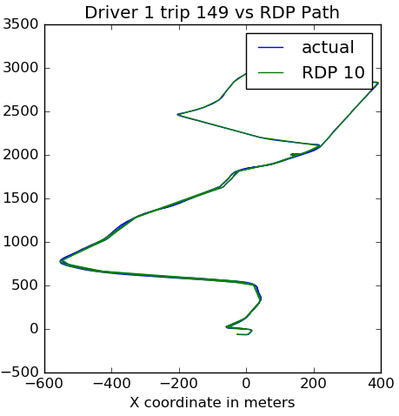
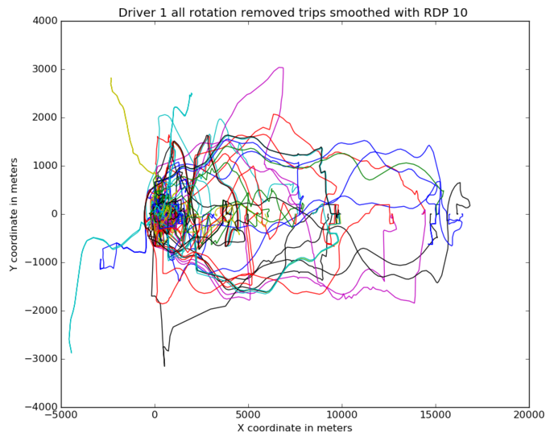
Feature: Repeated Trips –smoothed with RDP (before & after rotation removal)

Slide 26
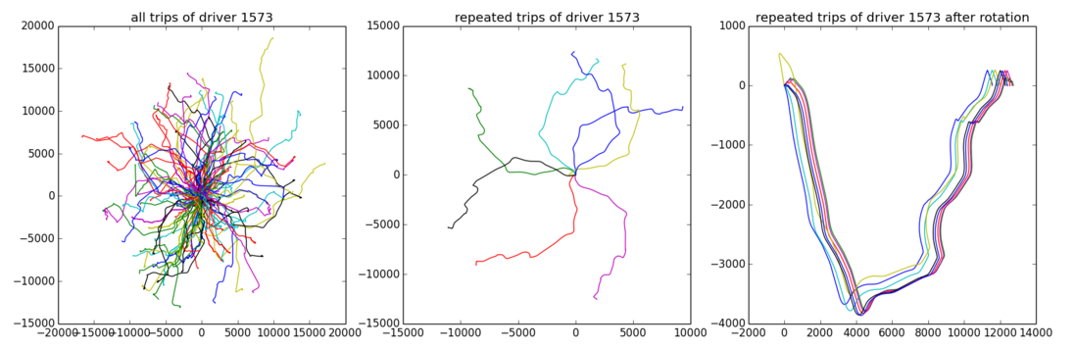
A very clear example of Repeated Trips from Challenge Teams

Slide 27
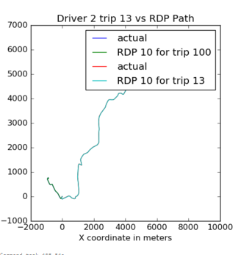
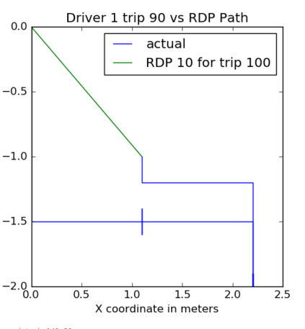
Feature: Repeated Trips (some RDP outliers)

Slide 28
Modelling Process (1/2): Options
Clustering
Pros: Easy to implement
Cons: Less control, flexibility, insight and options for modelling
*Can be rather used as preprocessing step in this case
Multi-class Supervised Classification
Pros: Relatively easier to implement than Binary Class. Classification, Less Performance Cost
Cons: Not very robust in case when 2 drivers have similar trips
Binary-class Supervised Classification
Pros: Much more robust than the others in this problem case, more variation of algorithms
Cons: Complex (dealing with skewed data structure, since those that are not belonging to driver of interest are few) and Costly to implement training phase

Slide 29
Modelling Process (2/2): Training, Test & Prediction Methodology
FOR EACH DRIVER -------------------------------------------------------------------------------------->
DRIVER 1 TRAIN DATASET
%90 Train(180)→Label 1
Driver 1 (200)
%50 Train(180)→Label 1
10 Fold Cross Validation
With Hyperparameter Grid Search Opt.
%10 Test (20)→Label 1
Driver 2 (200)
%50 Train(180)→Label 0
Driver 3 (200)
%90 Train(180)→Label 0
DRIVER 1 Best Model
Randomly from other drivers
DRIVER 1 TEST DATASET
Driver 4 (200)
%10 Test (20)→Label 0
%50 Train(20)→Label 1
TRANSFORM
Driver ….(200)
%50 Train(20)→Label 0
Model Ok?
EVALUATE
Driver N (200)
PREDICT PROBABILITIES
Driver 1 (200)

Slide 30
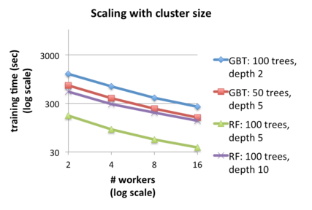
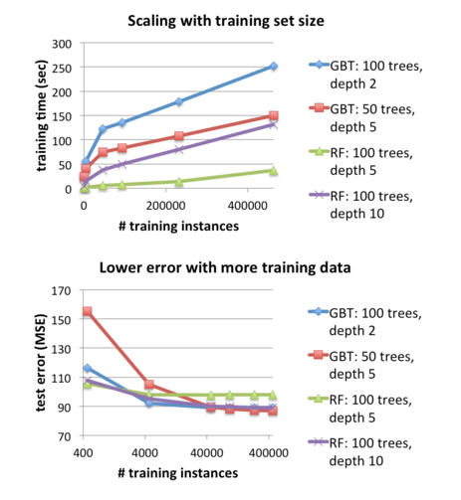
Modelling: Training Phase Performance
I executed Mllib Random Forest Classifier with 10 workers over 5 nodes

Slide 31
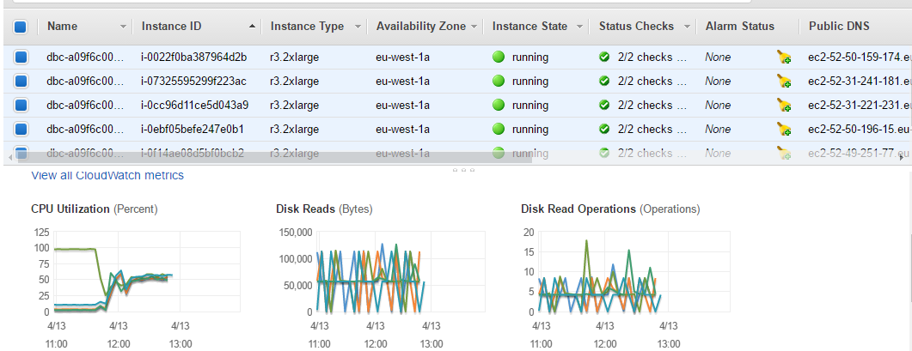
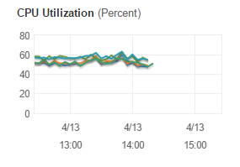
Modelling: Training Phase Performance
Before
Databricks
Hive Table
Caching
(with regular
caching)
After
Table
Caching
Steady State for Training 100 Drivers
With Multi-Threading
& TRAINING table caching

Slide 32
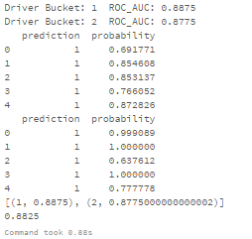
Evaluation: First Test with Random Forest (Driver 1 & 2)

Slide 33
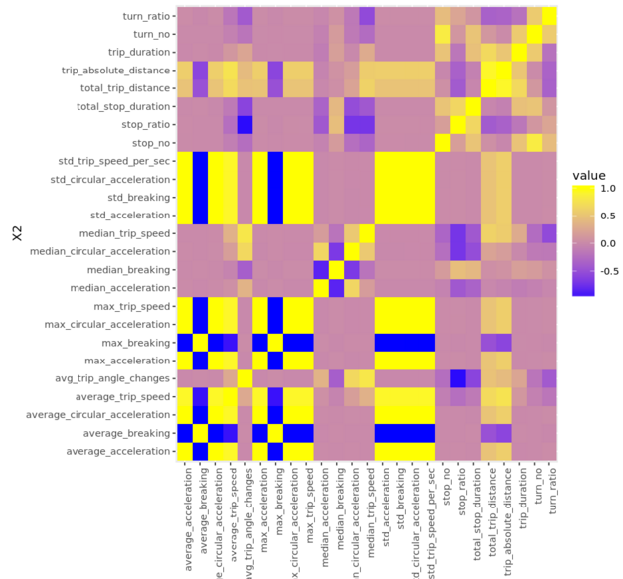
Feature Selection
Due to high correlation,
max_breaking, average_circular_acceleration, average_trip_speed
max_circular_acceleration
are removed from feature space.
std_circular_acceleration was also a candidate for removal; but I observed it might be an important variable since there has been test ROC evaluation decrease due to its removal.

Slide 34
Feature Selection
Information Values:
I would like to use IV for Random Forest Classifier however there is no attribute in Python-Spark (Pyspark) to obtain Ivs for feature Selection.
It is currently available for Scala.

Slide 35
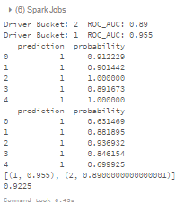
Evaluation: Random Forest after feature selection (Driver 1 & 2)

Slide 36
EVALUATION: FULL DATASET RESULTS
THIS SECTION WILL BE ADDED SOON CURRENTLY, THE FINAL TRAINING EXECUTION ON FULL DATASET CONTINUES
THANK YOU FOR YOUR PATIENCE

Slide 37
What can be improved?
Just like 2nd prize winner creating multiple feature sets and training different ensembles (ensembles of ensembles and other simpler classification algorithms) and assigning them weights
We could calibrate different classifiers with Lasso linear model
During the training and test data set preparation, in order to obtain more robust models we could sample randomly multiple times of 200 and balance it by duplicating the samples retrieved from the driver of interest
Trip matching could be completed
I could have added turning speed feature
Acceleration and Speed outliers should have been removed

Slide 38
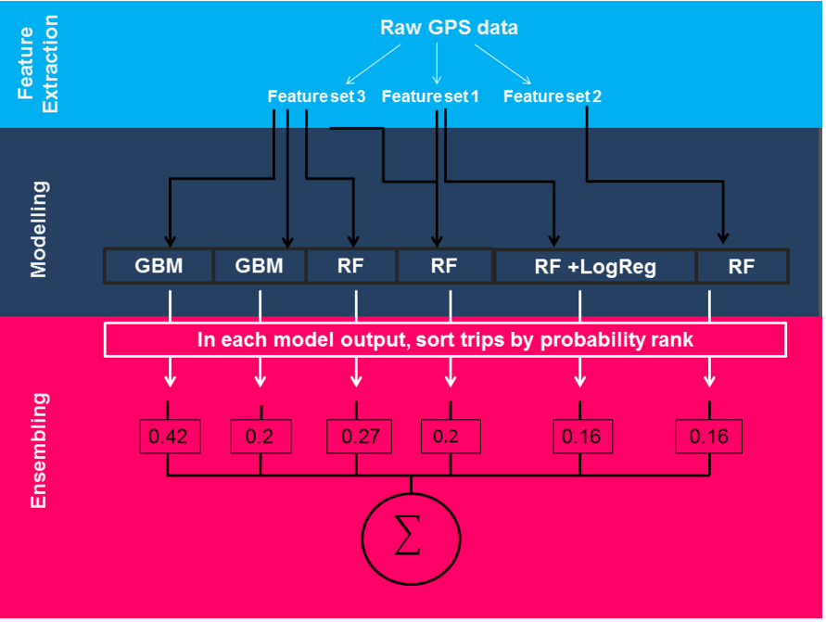
Different Methodology from Kaggle Winner
2nd prize winning solution

